Slide 1
Beyond the standup
Why effective culture is essential to successful teams
Dr. Dhru Beeharilal
Nayan Leadership

Slide 2
Agenda
Introduction
What is effective Culture?
Discuss the cause and effects of poor Culture
How to build effective Culture
Q & A
Final thoughts & takeaways

Slide 3
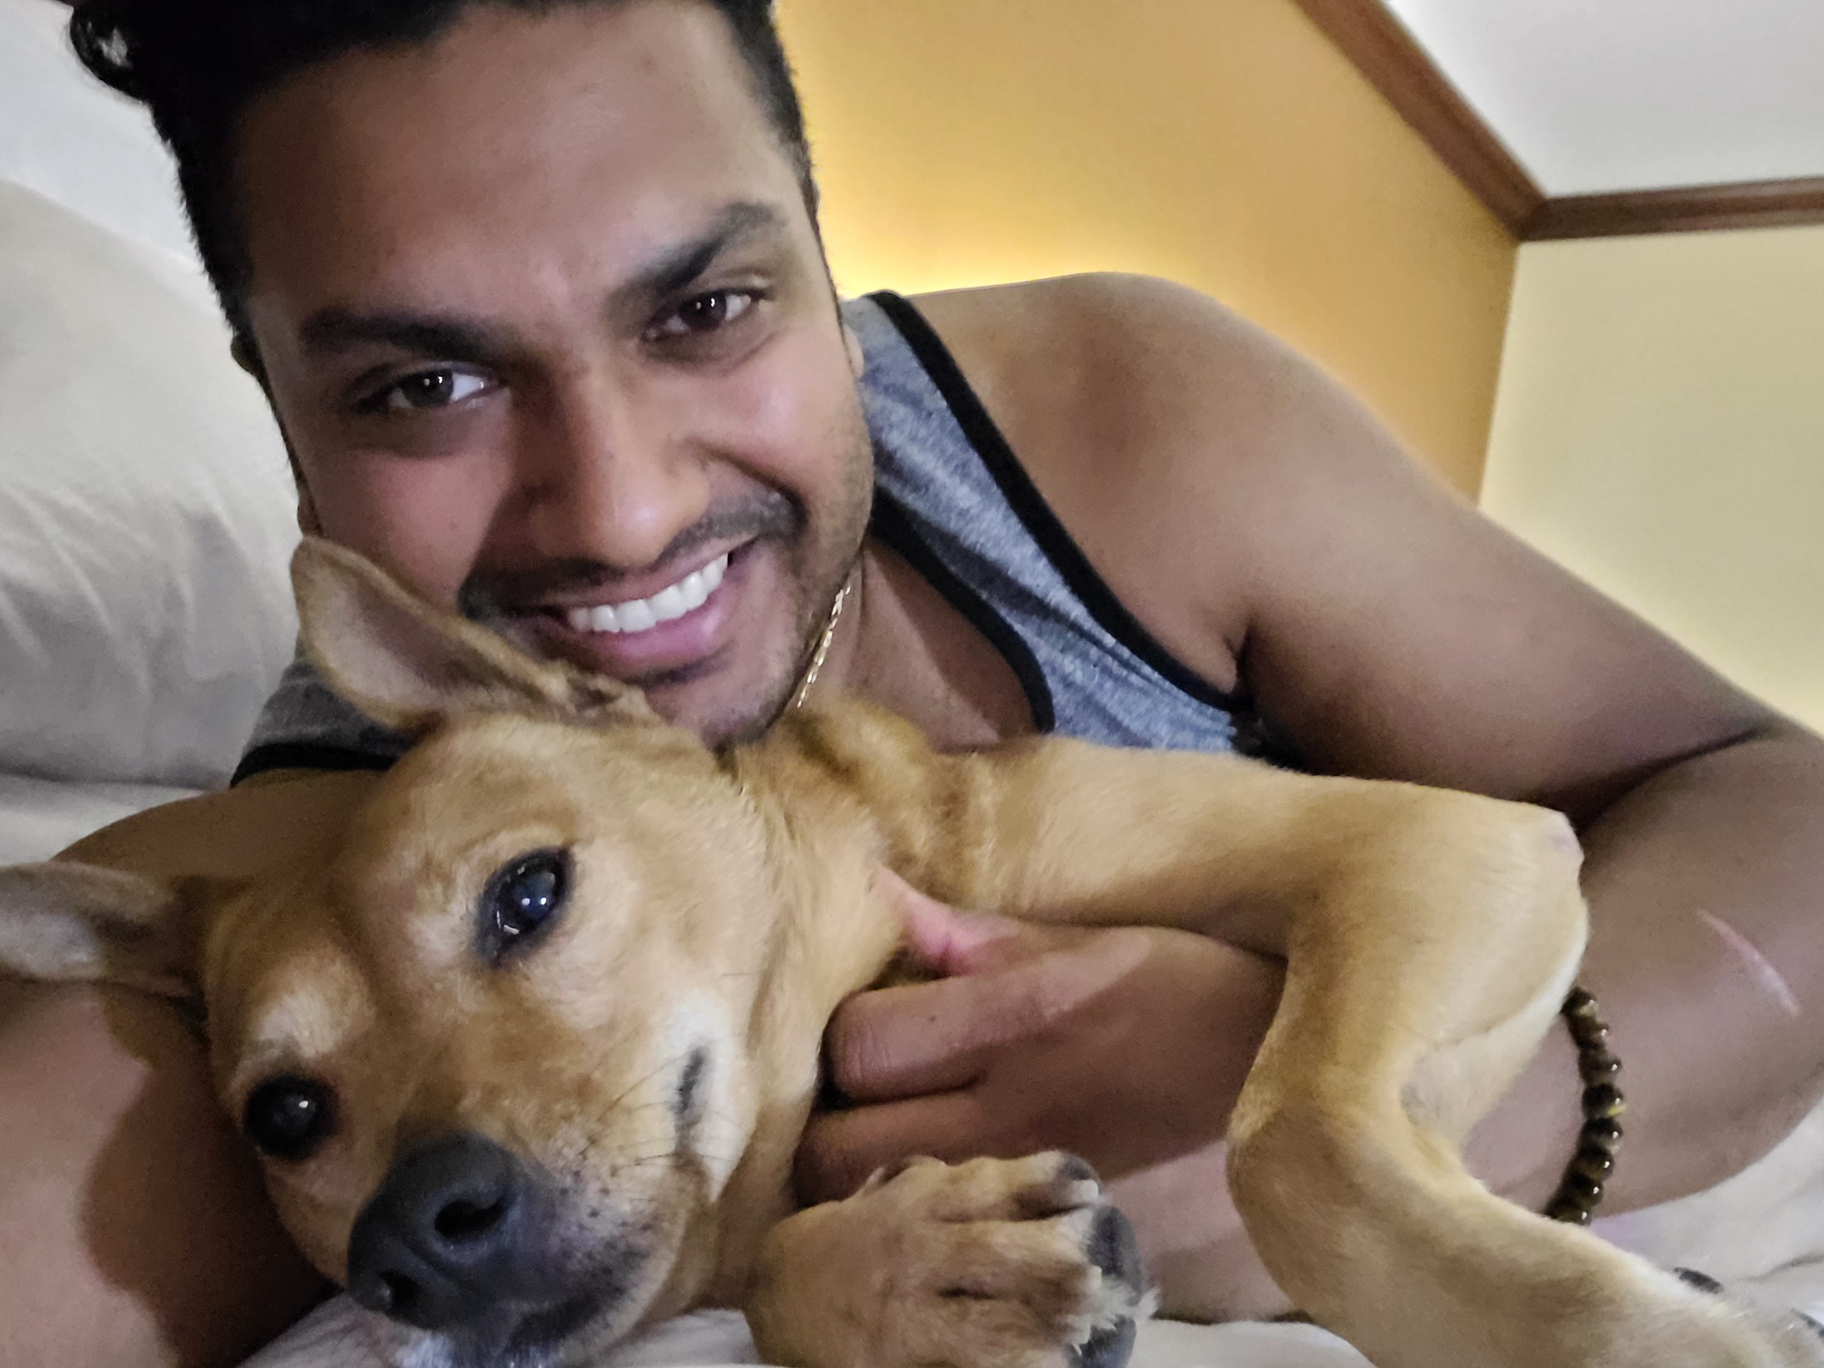
Who is Dhru?
Founder and CEO of Nayan Leadership and HachiMedia
Business and leadership mindset coach
Artist, photographer, author, serial entrepreneur, speaker, creator
Recovering attorney and IT Consultant
Huge nerd
Dog dad
Explorer

Slide 4
Question
What is
Effective culture?
Notes:
Poll audience
Answer after Case Study

Slide 5
Case Study
COMPANY X
Notes:
Invested upwards of $300k on “tools”

Slide 6
Company x – Initial state
Running “Agile”
Two department collaboration
Constant territory disputes
Lack of cooperation and visibility on both sides
2 years behind on a 6-month project (scope creep)
Lost 7 resources in prior 6 months

Slide 7
Company x – “FrAgile”
Inconsistent capacity
Inconsistency of scoring stories and tasks
No designated Product Owner
Scrum Master not empowered
1-hour standup meetings
CYA mentality
Notes:
So what was the culture like?

Slide 8
ACTIVITY
What one thing is most determinative of culture?
Notes:
7 minutes
Discuss amongst yourselves

Slide 9
What is Effective Culture?
Hierarchical or flat – doesn’t matter, if done right
Clear RACI and roles defined
Clear and open communication
Collaborative, strength-based, and weakness-aware
Everyone has a voice
Strong leadership
Notes:
So what was the leadership like at Company X?

Slide 10
Company x - Sponsors
Highly engaged and involved
Uncooperative
Lack of time
Lack of trust
Indecisive and territorial

Slide 11
People don’t leave bad jobs.
People leave bad leaders.

Slide 12
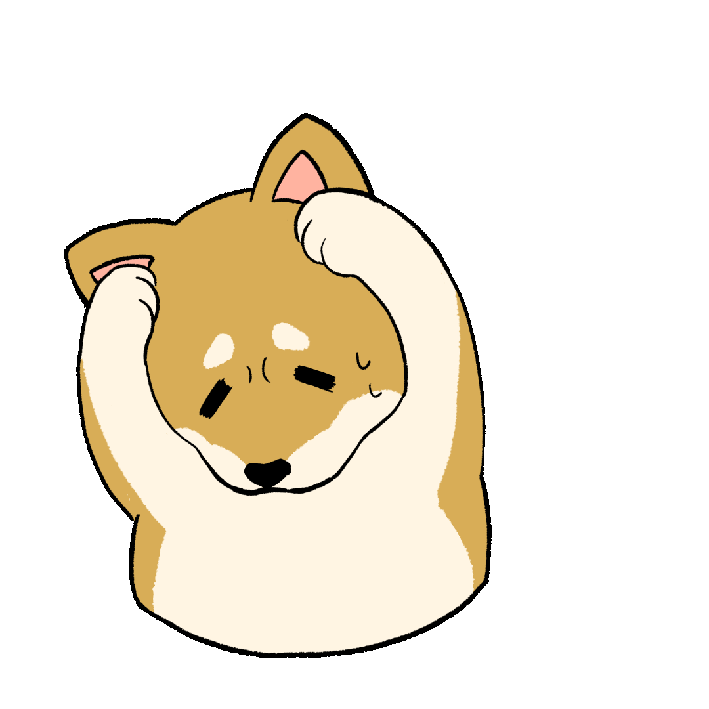
The cycle of poor leadership
POOR CULTURE
POOR WORK-LIFE BALANCE
HIGH TURNOVER
RUSHED HIRING
HIRING POOR FIT
POOR LEADERSHIP

Slide 13
How did we fix it?
New Process? Wouldn’t stick
New Tools? Useless without wielders who could STAY
New Training? Waste of money with high turnover

Slide 14
Question
What is
the riddle of steel?
Notes:
Tools don’t make something effective or not
The WIELDER does
Tools alone don’t do anything

Slide 15
How did we fix it?
Engage with the Sponsors to engage with each other
Install a Product Owner
Empower Scrum Master
Team building
360 Assessments all around
Agile Coaching (Team)
Leadership Coaching (PO, SM, Tech Leads)

Slide 16
Company X – 18 months later
BEFORE
AFTER
“Me” culture
“FrAgile”
CYA
High turnover
No PO
Disempowered SM
Uncooperative sponsors
“We” culture
Agile
Transparent communication
Consistent, committed team
Empowered PO
Empowered SM
Sponsor support*
Notes:
Support – meaning they supported and empowered the PO and SM to make decisions and move forward
Turnover went from 7 people/6 months to 0 turnover for the last 6 of the 18 months, then 1 person in the following 12 months

Slide 17
Wrapping it all up
People don’t leave bad jobs, they leave bad leaders
Diverse teams are stronger, and diversity doesn’t look just one way. Assemble a team with diverse perspectives. Period.
Accept feedback, iterate, and innovate quality products and services for repeat clients
Stakeholder engagement is essential, in the right way
Leadership is the key to effective culture and ultimately success
Skills can be taught; mindset cannot

Slide 19
THANK YOU
Dr. Dhru Beeharilal
Nayan Leadership, LLC
www.linktr.ee/dhrubee

